Slide 1
ASP.NET MVC CORE
Instructor: Edwin oduor

Slide 2

Quote of the day

Slide 3
Lesson objectives
Creating pages
Creating Links to navigate through the pages

Slide 4
Lesson pre-requisites
In order to take full advantage of this section you need to have the following;
Computer with Visual Studio Installed.
Stable Network Connection.

Slide 5
Training methods and extra readings
TRAINING METHODS FOR THIS LESSON
EXTRA READINGS
Lecturing Method – This is the main method of training to be adopted in this lesson with illustrations and practical coding examples.
Discussion Method - This method will be adopted periodically whereby learning will be derived principally from the students brainstorming together, rather than from the trainer. Three main types of discussions will be used:
Directed discussion
Developmental discussion
Problem-Solving discussion
Home and Learn C#

Slide 6
CREATING A NEW PROJECT

Slide 7
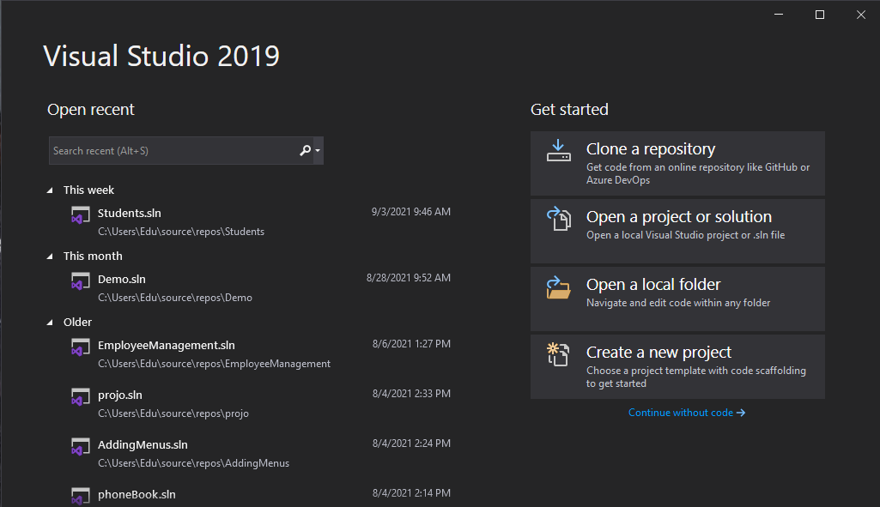
When creating a new project, start visual studio. You will see this screen displayed below.

Slide 8
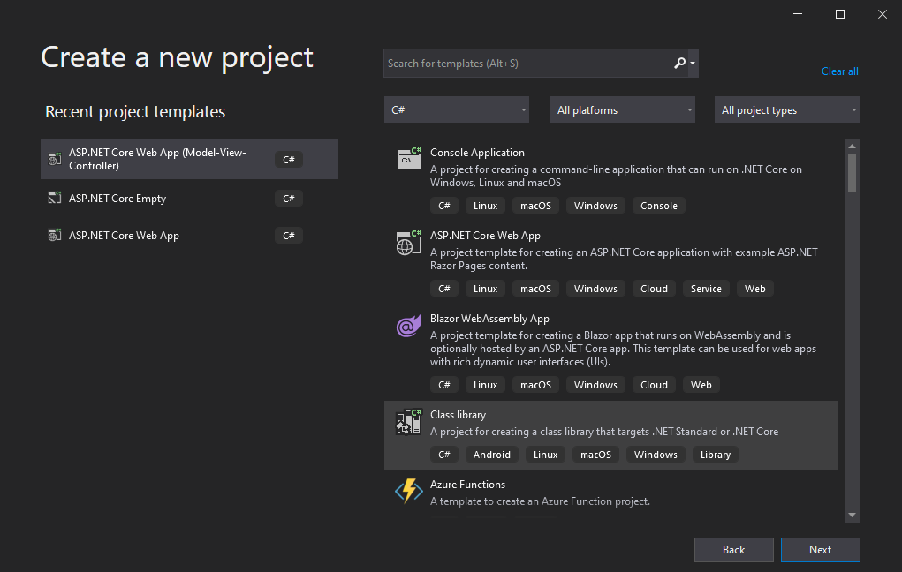
Click on Create new project. Once you click on create new project you will get the following window.

Slide 9
The one will create is ASP.NET core Web App (Model-View-Controller)

Slide 10
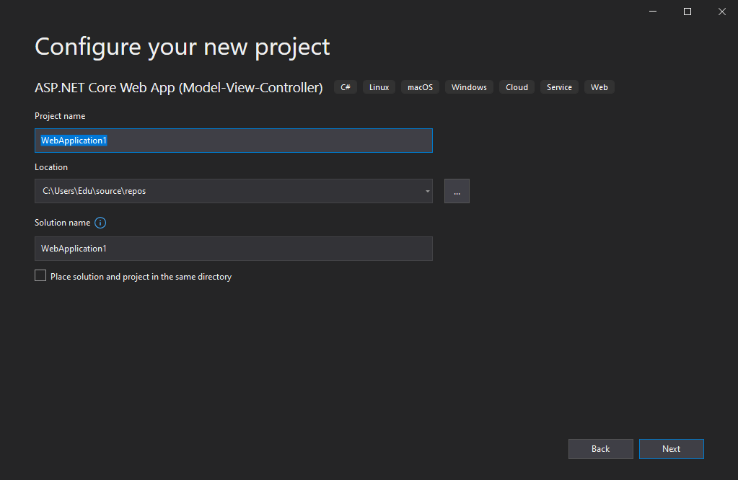
Click next, give your project a name (NavigationPages) and location to be stored. Click next

Slide 11
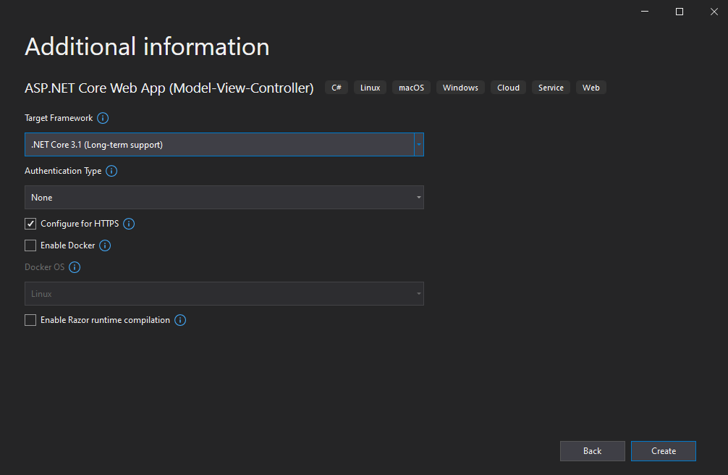
Specify the target frame work in our case will use 3.1 and uncheck configure for Https, click on Create. The project will now be successfully created.

Slide 12
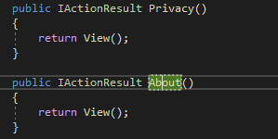
When we run our program by clicking on the play button. The program will run and when a link is clicked on, takes one to the page. That is perfect that shows that everything is working on well.
We will learn to add our own pages and when a link is clicked on it’s going to take us to the page that we have created.
Will go to the controllers folder, click on home controller, in the home controller we want to add a page, About Us. Will copy the IActionResult one of them paste it below one of the methods and change the name to About

Slide 13
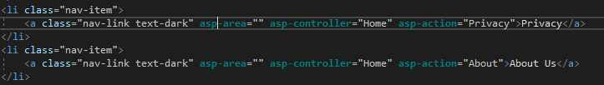
Right click on the IActionResult About >> click on AddView, when the AddView is clicked on the following dialogue box will be displayed. Choose razor view empty >> click add , give it the name About.
Once the IActionResult is added and the view the next thing is to create a link on the home controller page so that when it’s clicked on then the about us page is going to be displayed.
To do this will go to the shared folder _Layout.cshtml, Inside the file will create the link.
Will copy one of the links and paste it as the last item, change the asp-action to About, because in our home controller the IActionResult name is About, that is what we are referring to here.

Slide 14
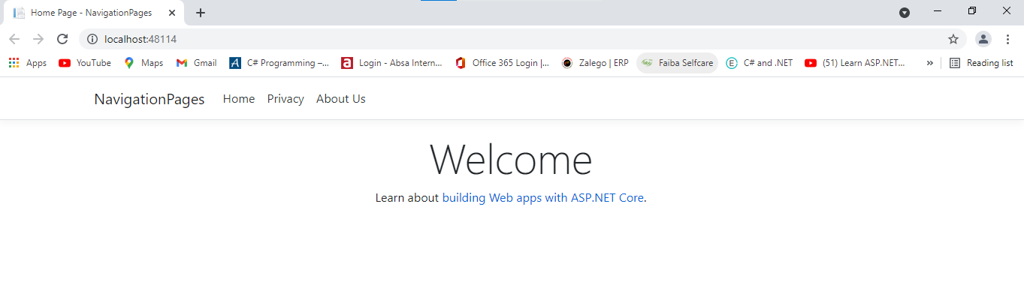
When we run our program, this is the output that we will get. You will notice that we have the About Us page added as one of the links, when it is clicked on it’s going to open the about us page.

Slide 15
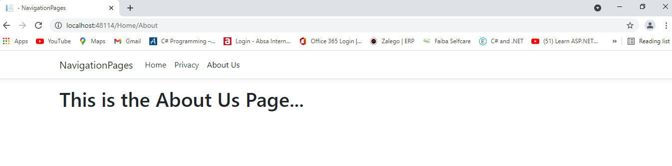
This is the output when the about us page is clicked on.

